Slide 1
M.O.R.E. Work Climate Change Policy Initiatives
PRESENTED BY
CORY CHANNON
International Director of Climate Change Policy Initiatives, M.O.R.E. WIF, SAIP, AD-CSO CAN

Slide 4
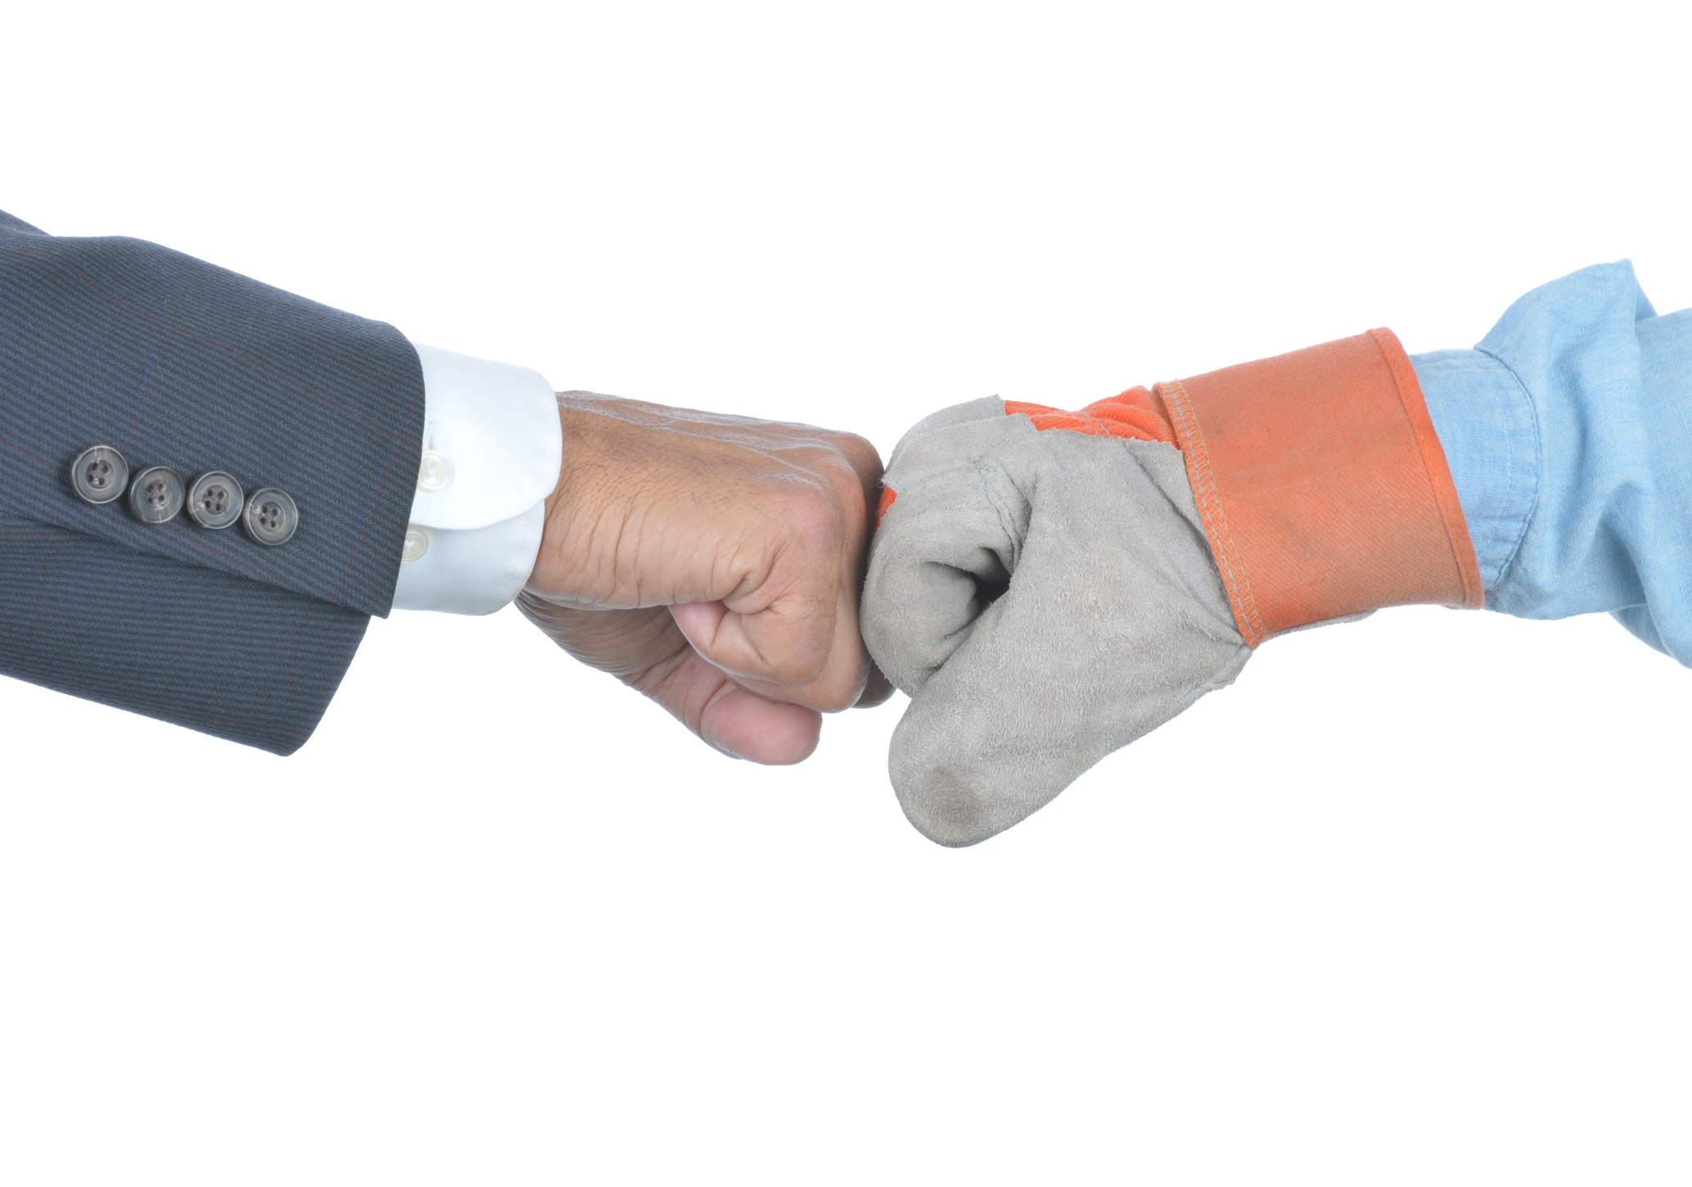

Slide 12
Questions?

Slide 13
Thank you and enjoy the conference
cchannon@boilermakers.org +1 780-886-4717

