Slide 1
Long-Standing & Mutually Beneficial Relationship
“A Different Kind of Energy Company”
March 28, 2023

Slide 2
Forward Looking / Cautionary Statements – Certain Terms
This document contains statements that we believe to be “forward-looking statements” within the meaning of Section 27A of the Securities Act of 1933 and Section 21E of the Securities Exchange Act of 1934. All statements other than historical facts are forward-looking statements, and include statements regarding our future financial position, business strategy, projected revenues, earnings, costs, capital expenditures and plans and objectives of management for the future. Words such as "expect," “could,” “may,” "anticipate," "intend," "plan," “ability,” "believe," "seek," "see," "will," "would," “estimate,” “forecast,” "target," “guidance,” “outlook,” “opportunity” or “strategy” or similar expressions are generally intended to identify forward-looking statements. Such forward-looking statements are subject to risks and uncertainties that could cause actual results to differ materially from those expressed in, or implied by, such statements.
Although we believe the expectations and forecasts reflected in our forward-looking statements are reasonable, they are inherently subject to numerous risks and uncertainties, most of which are difficult to predict and many of which are beyond our control. No assurance can be given that such forward-looking statements will be correct or achieved or that the assumptions are accurate or will not change over time. Particular uncertainties that could cause our actual results to be materially different than those expressed in our forward-looking statements include:
fluctuations in commodity prices, including supply and demand considerations for our products and services; decisions as to production levels and/or pricing by OPEC or U.S. producers in future periods; government policy, war and political conditions and events, including the war in Ukraine and oil sanctions on Russia, Iran and others; regulatory actions and changes that affect the oil and gas industry generally and us in particular, including (1) the availability or timing of, or conditions imposed on, permits and approvals necessary for drilling or development activities or our carbon management business; (2) the management of energy, water, land, greenhouse gases (GHGs) or other emissions, (3) the protection of health, safety and the environment, or (4) the transportation, marketing and sale of our products; the impact of inflation on future expenses and changes generally in the prices of goods and services; changes in business strategy and our capital plan; lower-than-expected production or higher-than-expected production decline rates; changes to our estimates of reserves and related future cash flows, including changes arising from our inability to develop such reserves in a timely manner, and any inability to replace such reserves; the recoverability of resources and unexpected geologic conditions; general economic conditions and trends, including conditions in the worldwide financial, trade and credit markets; production-sharing contracts' effects on production and operating costs; the lack of available equipment, service or labor price inflation; limitations on transportation or storage capacity and the need to shut-in wells; any failure of risk management; results from operations and competition in the industries in which we operate; our ability to realize the anticipated benefits from prior or future efforts to reduce costs; environmental risks and liability under federal, regional, state, provincial, tribal, local and international environmental laws and regulations (including remedial actions); the creditworthiness and performance of our counterparties, including financial institutions, operating partners, CCS project participants and other parties; | reorganization or restructuring of our operations; our ability to claim and utilize tax credits or other incentives in connection with our CCS projects, our ability to realize the benefits contemplated by our energy transition strategies and initiatives, including CCS projects and other renewable energy efforts; our ability to successfully identify, develop and finance carbon capture and storage projects and other renewable energy efforts, including those in connection with the Carbon TerraVault JV; our ability to successfully develop infrastructure projects and enter into third party contracts on contemplated terms; and uncertainty around the accounting of emissions and our ability to successfully gather and verify emissions data and other environmental impacts; changes to our dividend policy and share repurchase program, and our ability to declare future dividends or repurchase shares under our debt agreements; limitations on our financial flexibility due to existing and future debt; insufficient cash flow to fund our capital plan and other planned investments and return capital to shareholders; changes in interest rates; our access to and the terms of credit in commercial banking and capital markets, including our ability to refinance our debt or obtain separate financing for our carbon management business; changes in state, federal or international tax rates, including our ability to utilize our net operating loss carryforwards to reduce our income tax obligations; effects of hedging transactions; the effect of our stock price on costs associated with incentive compensation; inability to enter into desirable transactions, including joint ventures, divestitures of oil and natural gas properties and real estate, and acquisitions, and our ability to achieve any expected synergies; disruptions due to earthquakes, forest fires, floods or other natural occurrences, accidents, mechanical failures, power outages, transportation or storage constraints, labor difficulties, cybersecurity breaches or attacks or other catastrophic events; pandemics, epidemics, outbreaks, or other public health events, such as the COVID-19; and other factors discussed in Part I, Item 1A – Risk Factors.
We caution you not to place undue reliance on forward-looking statements contained in this document, which speak only as of the filing date, and we undertake no obligation to update this information. This document may also contain information from third party sources. This data may involve a number of assumptions and limitations, and we have not independently verified them and do not warrant the accuracy or completeness of such third-party information.
2

Slide 3
Michael Preston

Slide 4

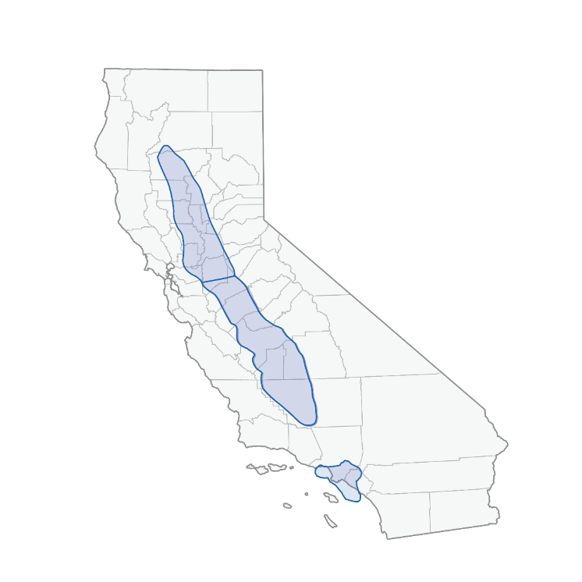






Delivered on Our 2022 Priorities
91 MBOE/D
2022 NET PRODUCTION
4
ACTIVE DRILING RIGS¹
DELIVERED STRONG RESULTS
Record Cash Flow
Shareholder Returns
$690MM
$372MM
2022 OCF
2022 Shareholder Returns Program & Dividends
California’s Largest and Domestically Lowest Carbon Intensity Producer²
Invested
Maintained
$242MM
~57 MBO/D
Of 2022 E&P Drilling & Completions Capital
Entry to Exit Oil Production⁴
Low Carbon Intensity
Production
Midstream Infrastructure
EXPANDED THE CARBON MANAGEMENT BUSINESS
Carbon Capture & Storage
Formed An Industry Leading
Announced 2 CDMAS⁵ For
BTM Solar Opportunities
CTV JV
470,000MTPA
FTM/Grid Power Production
With Brookfield Renewable
Of Greenfield Projects
Geothermal Opportunities
Submitted to EPA
Formed
140MMT
California DAC Hub
$9.2B
PV-10 OF 2022 PROVED RESERVES³
200MMT
YE27 CTV JV Storage capacity target
Of CO₂ Reservoirs for Class VI Permits
Consortium
417 MMBOE
(1) Average rig count over 2022. (2) Source: Enverus; CARB; CATF. (3) PV-10 is a non-GAAP measure. Please see the Investor Relations page at www.crc.com for a reconciliation of PV-10 using SEC Prices to the nearest GAAP equivalent and other additional information. PV-10 of reserves estimated as of December 31, 2022 using SEC Prices (after factoring in price realizations) of $97.50 per barrel for oil, $67.83 per barrel for NGLs and $7.84 per Mcf for natural gas. (4) Net oil production at January 2022 entry has been reduced by 2.3 MBO/D due to divested assets in Ventura and Lost Hills. (5) CDMA: Carbon Management Agreement.
4
Notes:
Simplify ….

Slide 5
Long-Standing Relationship with Unions Through Project Labor Agreement (PLA)
CRC Has the Lowest Carbon Intensity Oil & Natural Gas Resources in the U.S^{.1:} unlike imported energy, CRC’s resources have been produced under the state’s world-leading safety, labor, human rights and environmental standards
CRC is Invested in California People: CRC is working with some of the largest employee unions in California (e.g. California State Building and Construction Trades Council and Locals 1309, 428, 11, 460, 250, 12 and others) and continues to support local employment
CRC is Providing Competitive Wages To The Community: Over 4.2MM working hours billed in 2022². Many union suppliers have significant local investments in warehouses, logistics assets, heavy equipment purchased in California and other employees locally employed (accountants, safety personnel, sales and management)
CRC’s Carbon Capture & Storage(CCS) Strategy Drives Higher Wages and Energy Transition Job Opportunities in California: CRC expects to add high-paying jobs by developing CCS opportunities as a result of Inflation Reduction Act (45Q)^{3.} The prevailing wage and apprenticeship requirements are focused on making sure that projects provide well-paying jobs and training opportunities
Throughout 2022, CRC employed more than 2,000 contractors⁴
PLA Historical Spending²
PLA Contractor Workload
Year | Amount ($MM)
2019A | $102.5MM
2020A | $80.2MM
2021A | $88.5MM
2022A | $117.3MM
2023 YTD | $11.7MM
Categories | Union Crafts
Civil Construction and Engineering Services | Boilermakers
Construction Services | Carpenters
Crane Equipment and Services | Electricians
Electrical Construction and Installation, Maintenance Services | Insulators
Excavating and Dirtwork Services | Iron Workers
Hydrovac Services | Laborers
Maintenance Repair and Operating Supplies | Masons
Mechanical Construction and Installation, Maintenance Services | Operators
Pipeline Installation Services | Painters
Rotating Equipment | Pipefitters
Sandblasting, Coating, Painting and Associated Services | Teamsters
5
(1) Source: CATF. (2) Internal data. (3) Source: State of California. (4) Based on the assumption of an 8-hour day, 52-week year and 4.29MM billed hours in 2022.

Slide 6
Building on our Momentum to Accelerate The Carbon Management Business
Early-Stage Development Goals
2023 Outlook…
California’s First CCS Storage Project
Introducing Carbon TerraVault Board of Directors
Targeting First Class VI EPA Draft Permit by YE2023⁵
Submission of additional reservoirs for EPA Class VI permitting
Advancing New CDMAs
Carbon TerraVault Is Born
200MMT of Class VI permits submitted by YE25
Begin 1MMTPA Injection by YE25
Begin 5MMTPA injection by YE27
CTV JV With Brookfield Renewable
California DAC Hub Consortium
Up to 1BMT CO₂ Storage Opportunity
Initial 200MMT of CO₂ in Focus
Submitted CTV Class VI Permit for CTV I (26R)
100,000MTPA Blue Hydrogen Facility storage-only project at CTV I
Capital Costs and EBITDA within previously disclosed Type Curve²
Announced Net Zero Industrial Park at Elk Hills
Initial commitment of
$500MM from BGTF¹
Kern County Energy Transition Investment
Accelerating DAC+S in California through its wholly owned subsidiary CTV Direct
The first DAC Hub is targeted for Kern County and is expected to store CO₂ at the CTV I reservoir
2022
2023
2024
Submitted CTV Class VI Permit for CTV I (A1/A2)
Defined a path to reduce CRC’s Scope 1,2 and 3 emissions
Expanded CCS total market opportunity to include New Energy Economy emissions
Inflation Reduction Act: 45Q tax Incentive rose to $85/MT for Carbon Storage³
Completion of NextDecade Feed Study
Targeting to FID CalCapture in 1H24
Targeting to FID Lone Cypress Project in YE23⁵
370,000MTPA Blue Ammonia and Hydrogen Facility at CTV III
Capital Costs and EBITDA within previously disclosed Type Curve²
Decarbonizing California’s Agricultural Sector
Submitted CTV Class VI Permit for CTV II and III
Announced NextDecade CalCapture Feed Study
Defined CRC’s ESG Goals
Advancing CalCapture & Lone Cypress Project to The Next Stage of Development
2045 Net Zero Goals
Expanded California’s CCS Market Opportunity By 2.4x⁴
Blue NH₃ and H₂ Facility CO₂ Storage Project
Introduced CTV to Northern California
Positioned to Be California’s Premier Carbon Management Provider
Source: CRC unless otherwise stated. {1) Brookfield Global Transition Fund. Initial commitment applies to CCS projects that are jointly approved through the CTV JV. (2) EBITDA is a non-GAAP measure. For all historical non-GAAP financial measures please see the Investor Relations page at www.crc.com for a reconciliation to the nearest GAAP equivalent and other additional information. Note CTV JV EBITDA estimates include 45Q tax credits. See slides 27, 28 and 38 of CRC’s 3Q22 Earnings slides for detailed information on the previously disclosed Type Curve. (3) Source: Inflation Reduction Act. (4) Source: Energy Futures Initiative and Stanford University. “An Action Plan for Carbon Capture and Storage in California: Opportunities, Challenges, and Solutions.” October 2020; EPA; NATCARB; CARB; Internal estimates; Includes Brownfield and Greenfield opportunities; CARB Scoping Plan: AB32 Source Emissions Final Modeling Results, October 28, 2022; Department of Energy Hydrogen Program Plan, U.S. Department of Energy, November 2020. Converted from CARB’s estimated 13% of U.S. hydrogen demand of 21 – 44MMTPA. (5) Draft permit expected by YE23, but is subject to EPA approvals and public review. FID subject to permit approvals.
6
Notes:
Continuing to file permits and sign CDMAs – less numbers
279 – 320 - $70
329 – 370 - $80
359 – 400 - $90
Remove the goals

Slide 7
Growing Energy Transition Employment Opportunities By Decarbonizing California

Slide 8



California Air Resources Board (CARB) 2022 Climate Change Scoping Plan
Governor Newsom’s Response to CARB
CCS Plays an Increasing Role in California’s Carbon Neutrality Goals as Part of CARB 2022
“Simply put, it will not be possible to eliminate all emissions across our economy, so achieving carbon neutrality will rely on carbon sequestration.”
CARB 2022 Scoping Plan emphasizes the need to deploy all viable tools including carbon capture and sequestration
Plan outlines course of action to achieve carbon neutrality by 2045 or sooner
California’s legislative action towards carbon neutrality reduces risk and incentivizes long-term investments in CCS
Proposed California Climate Commitment will bring California’s multi-year climate investment to $54B
CCS is recognized among California state officials to be an important strategy for carbon removal at scale
Governor Newsom requested CARB set a 20MMT and 100MMT carbon removal target for 2030 and 2045
“… engineered carbon removal is clearly needed to achieve the scale of carbon removal required to reach carbon neutrality.”
- G. Newsom, Governor of California
Letter to the Chair of California Air Resources Board, July 22, 2022
CRC is aligned with California’s 2045 carbon neutrality goals
8
Notes:
https://www.gov.ca.gov/wp-content/uploads/2022/07/07.22.2022-Governors-Letter-to-CARB.pdf?emrc=1054d6

Slide 9

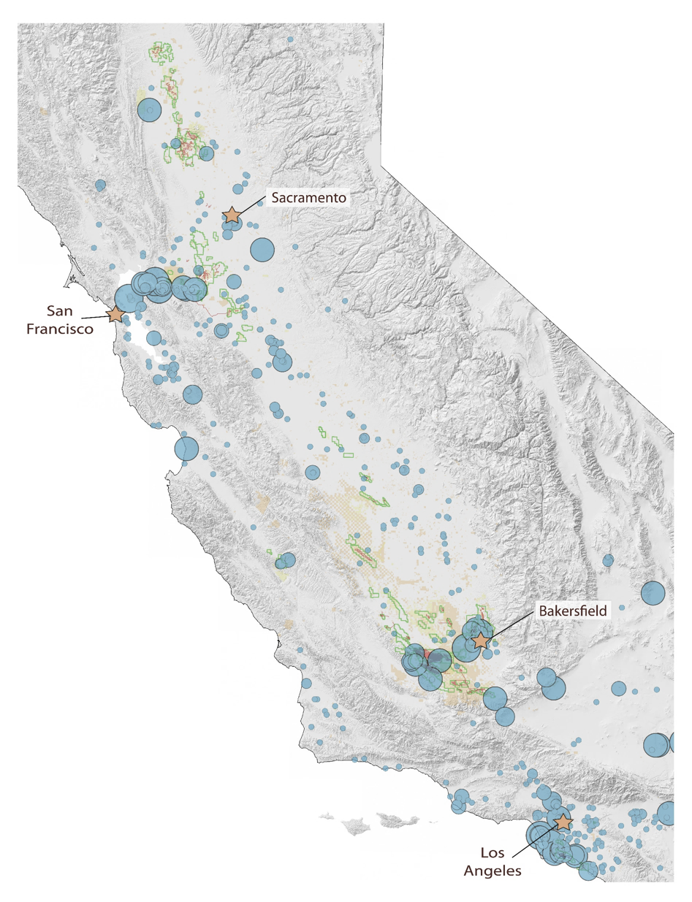
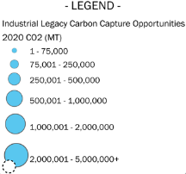
CCS Technology Can Enable a Lower Carbon Future and CTV is Well Positioned to Provide It
Application |  | Requirements
Capture |  | High concentration of emitters near CRC reservoirs eligible for LCFS credits Strong historical relationships with major petrochemical complexes in the state Access to capital markets and innovation hubs Understanding of the commercial and engineering CO₂ capture market from CalCapture and DOE FEED study evaluation
Transportation |  | Proximity to CO₂ source Ability to leverage key infrastructure in place Access to supply chain distribution network Midstream experience
Storage |  | Experienced subsurface, reservoir and injection management capabilities Fully developed static and dynamic reservoir models Largest fee position in the state Experience with municipal, county, state & federal permitting agencies Identified up to 1BMT of potential storage capacity¹
Use |  | Proximity to CO₂ sources and petrochemical complexes Presence in the large consumption market Access to vast transportation & aerospace network
CRC has identified potential total CO₂ storage opportunities of up to ~1BMT¹
2
California’s economy could see rapid near-term emission reduction benefits from CCS
Immediate emissions reductions
Clean, safe and affordable energy
Low carbon baseload power
Global technological leadership
9
Note: (1) Source: Internal estimates. (2) CARB 2020.
Notes:
CRC’s CalCapture project is one of only 9 CO2 capture projects selected by the DOE to perform a FEED study, giving us a head start in understanding the commercial and engineering capture market.
https://iea.blob.core.windows.net/assets/181b48b4-323f-454d-96fb-0bb1889d96a9/CCUS_in_clean_energy_transitions.pdf
Carbon Capture Technology
Absorption Processes
Adsorption Capture
Fuel Cell Processes
Membrane Capture
Other CO₂ Technologies
Oxy-combustion
Bio-waste Gasification
Ammonia/Ethanol plant
A typical passenger vehicle emits about 4.6 metric tons of carbon dioxide per year.
https://www.epa.gov/greenvehicles/greenhouse-gas-emissions-typical-passenger-vehicle#:~:text=typical%20passenger%20vehicle%3F-,A%20typical%20passenger%20vehicle%20emits%20about%204.6%20metric%20tons%20of,8%2C887%20grams%20of%20CO2.

Slide 10
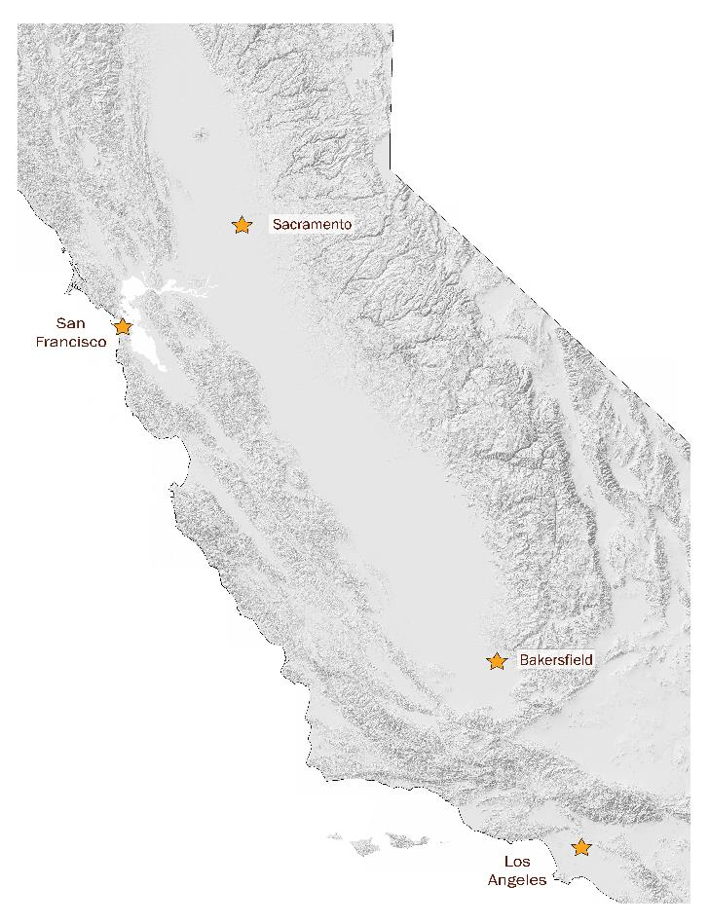



CRC is Decarbonizing California and Building a Diversified Portfolio of CO₂ Emissions
Expecting to Further Diversify CTV’s Portfolio of Emitters Across The Energy Spectrum in California
California’s Potential Addressable CCS Market Size by 2045
~150 to 210 MMTPA or more
Continuing to attract new emissions sources due to ideal conditions for greenfield and existing sources projects (Subsurface knowledge, technical expertise, assets’ location, access to capital, permitting process & etc.)
Project Type¹ | Tech | Greenfield |  |  |  |  | Existing Sources
Type of Emitter | DAC | Renewable Diesel | Ammonia | Hydrogen | Ethanol | Ethanol | Refiners, Cement, Steam Generators and Natural Gas Power Plants (incl. CalCapture)
Cost of Capture ($/TCO₂) | Very High | Medium | Low | Medium | Low | Low | Medium to High
Concentration of CO₂ | Very Low | Medium | High | Medium | High | High | Low to Medium
LCFS Eligible? | Yes, plus Incremental Incentives | Yes | Depends on Use | Depends on Use | Yes | Yes | Depends on Use
Source: Internal estimates.
10
Notes:
Consistent repeatable cash flows, capital allocation discipline, advancing and accelerating the carbon management business
May start marketing parts of HB next year
What slides are necessary and what slide are appendix
Problematic to show breakdown

Slide 11







California’s First Blue Hydrogen Project
CDMA DETAILS FOR CTV I’s FIRST STORAGE PROJECT
PROJECT DETAILS
Lone Cypress to construct a 30 tons per day (TPD) blue hydrogen facility at Elk Hills using its proprietary technology
CTV JV will provide permanent sequestration for 100,000 MTPA using CTV I 26R storage vault, including the lease of land for the blue hydrogen facility
Project FID targeted in late 2023; commercial operations targeted in late 2025
Combination of CTV I first storage project and Lone Cypress hydrogen facility will be eligible for 45Q tax credits as well as LCFS credits²
Expansion of the blue hydrogen facility to 60 tons per day is under consideration
CO₂ INJECTION RATE
(MTPA)
200,000 MTPA
PROJECT EST. CAPITAL
REQUIREMENTS ($/MT)
LIMITED DUE TO PROJECT”S LOCATION AND INTEGRATED CARBON CAPTURE SYSTEM
PROJECT EST. EBITDA⁴
($/ MT)
WITHIN OUR PREVIOULSY DISCLOSED TYPE CURVE¹ OF $50 TO $75 OF EBITDA⁴ PER MT OF CO₂ FOR A STORAGE-ONLY SOLUTION
The project is expected to provide at its peak approximatively 125 temporary construction jobs and 18 permanent technical jobs
The Carbon Dioxide Management Agreement (CDMA) Outlines Material Economics and Key Terms and Provides a Clear Path for the Parties to Negotiate Definitive Documents and Reach Final Investment Decision
Note: The exact Lone Cypress Hydrogen Project location within Elk Hills is TBD. (1) See slides 27, 28, 30 and 38 of CRC’s 3Q22 earnings deck for the latest details on the CTV JV project economic type curve. (2) This project would qualify for LCFS credits to the extent it sells the blue hydrogen to the mobility market (e.g.,hydrogen powered vehicles). (3) Earnings before interest, taxes, depreciation and amortization (EBITDA) is a non-GAAP measure. EBITDA estimates include 45Q tax credits. (4) Depicts illustrative examples of expected IRR, EBITDA and capital expenditure requirements based on internal estimates. Actual results could differ materially.
11

Slide 12


California’s First Blue Ammonia and Hydrogen Project
CDMA DETAILS FOR CTV’s FIRST BLUE AMMONIA & H₂ PROJECT
Grannus to construct a 150,000 metric tons per annum (MTPA) blue ammonia & 10,000 MTPA hydrogen facility at the CTV III location using its patented process design
CTV will provide permanent storage for 370,000 MTPA using its CTV III storage vault, including the CO₂ pipeline and the lease of land for the blue ammonia and hydrogen facility
Grannus has a master sales agreement¹ for up to CALAMCO’s total ammonia requirements for a maximum of 30-years. CALAMCO is a California-based cooperative made up of approximately 900 dealer and grower members and an investor in Grannus
While project FID and commercial operational dates are being further refined, at the latest the project is expected to be commercial by the end of 2027
Combination of CTV III’s storage project and Grannus blue ammonia and hydrogen facility will be eligible for 45Q tax credits as well as LCFS credits³
CTV will have an option to purchase equity in Grannus as well as a right of first refusal (ROFR) to provide storage services for subsequent Grannus ammonia and hydrogen projects in California
PROJECT DETAILS
CO₂ INJECTION RATE
(MTPA)
370,000 MTPA
PROJECT EST. CAPITAL
REQUIREMENTS ($/MT)
LIMITED DUE TO PROJECT”S LOCATION AND INTEGRATED CARBON CAPTURE SYSTEM
PROJECT EST. EBITDA⁴
($/ MT)
WITHIN OUR PREVIOULSY DISCLOSED TYPE CURVE¹ OF $50 TO $75 OF EBITDA⁴ PER MT OF CO₂ FOR A STORAGE-ONLY SOLUTION
OFFTAKE INTEREST
GRANNUS HAS ENTERED INTO A MASTER AMMONIA SALES AGREEMENT WITH CALAMCO IN AN AMOUNT UP TO ITS TOTAL AMMONIA REQUIREMENTS¹
The project is expected to provide at its peak approximately 250 temporary construction jobs and 31 permanent technical jobs
Note: The exact Grannus Blue Ammonia and Hydrogen Project location within CTV III is TBD. Blue ammonia is ammonia produced with near zero, or minimal carbon emissions. (1) A binding offtake agreement with respect to the Grannus Blue Ammonia and Hydrogen Project related to CTV III is subject to finalization and approval by Grannus and CALAMCO. (2) See slides 27, 28, 30 and 38 of CRC’s 3Q22 earnings deck for the latest details on the CTV project economic type curve. (3) This project would qualify for LCFS credits to the extent it sells the blue ammonia/hydrogen to the mobility market (e.g.,hydrogen powered vehicles). (4) Earnings before interest, taxes, depreciation and amortization (EBITDA) is a non-GAAP measure. EBITDA estimates include 45Q tax credits.
Notes:
Check on blue ammonia & transportation costs

Slide 13

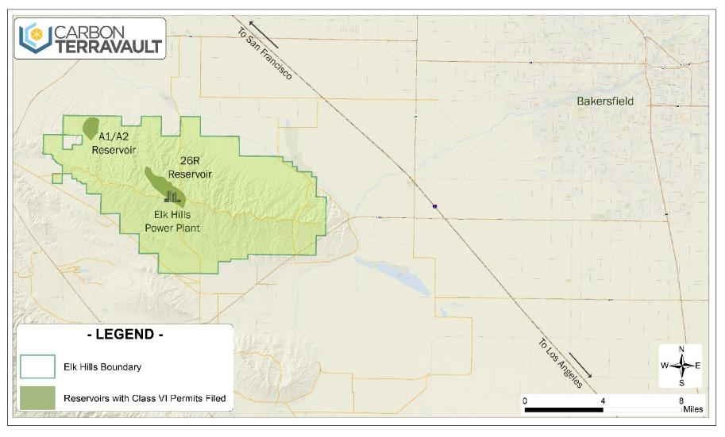


Leveraging CRC’s Flagship Elk Hills Asset to Create a Net Zero Industrial Park
Elk Hills provides ideal conditions to attract greenfield projects, given
  Large 47,000 acres land position at Elk Hills for potential infrastructure development
  Built out advanced infrastructure including midstream, roads, water, power and gas
  Proximity to ~40 MMT of EPA Class VI reservoirs with most advanced permits in California (filed in 2021)
  Additional Elk Hills reservoirs are currently being evaluated for new EPA Class VI permit applications
  By combining CRC’s Elk Hills surface acreage and world class CO₂ sequestration reservoirs, CTV JV can potentially replicate greenfield opportunities such as the Lone Cypress Hydrogen Project multiple times over to create a Net Zero Industrial Park
“We established ambitious and necessary goals to reduce carbon emission … We provided the tools industry needs to capture and store carbon before it hits the atmosphere … creating jobs that will support families across the state.”
- G. Newsom, Governor of California, November 16, 2022
Highlights CRC’s strong energy transition commitment through the economic repurposing of legacy assets and employment creation
        Provides incremental pore space to support the Net Zero Industrial Park
        Converts decommissioning liability from depleted reservoirs into revenue generating assets
        Access to land and amenities incentivizes low carbon investments
        Access to skilled energy transition workforce for operations and construction
Note: The exact Lone Cypress Hydrogen Project location within Elk Hills is TBD.

Slide 14
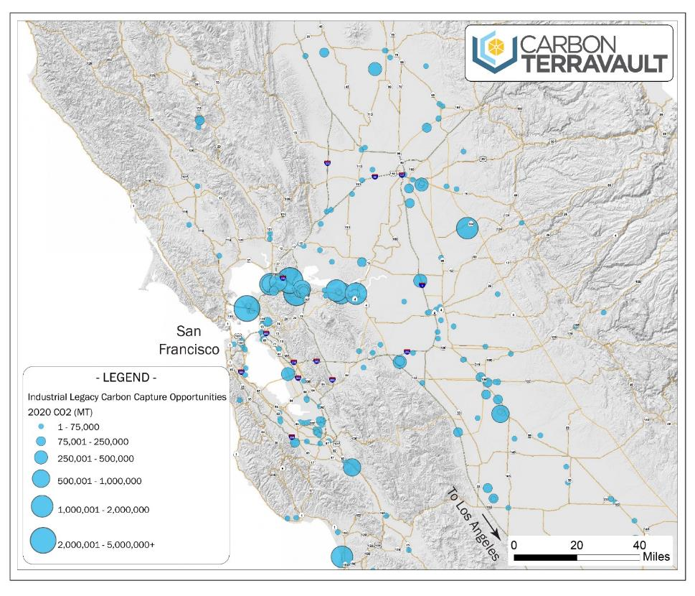

CTV Storage Vaults in Northern California Provide Further Opportunities For Growth
~100 MMT of CO₂ storage capacity vaults¹, or 2.5 MMTPA expected injection rate, submitted by CRC to EPA for Class VI permits in Northern California
Northern California has ~34% of California’s existing emissions² with most of them from hard to abate industrial sectors
Oakland is home to the ninth busiest container port in the United States where San Francisco Bay ranks among the four largest Pacific Coast ports for container cargo³
Agribusiness & Food Manufacturing represents a ~$3B industry in the Sacramento region⁴ with ~$1B of annual industrial dollar volume surrounding Sacramento⁵
Port of Stockton carries ~4MM tons of cargo every year and sits in the heart of the agricultural center of California⁶
CTV’s CO₂ storage assets are located in close proximity to the majority of existing emission sources in Northern California as well as potential to serve an emerging new energy economy
14
(1) Includes CTV II and CTV III. (2) Source: CARB 2020, represents legacy emissions within 100 miles of CTV III CO₂ storage vault. (3) Source: Oakland Sea Port. (4) Source: City of Sacramento. (5) Source: Colliers. (6) Source: Port of Stockton.

Slide 15
Developing A New and Technologically Advanced DAC Partnership In California

Slide 16
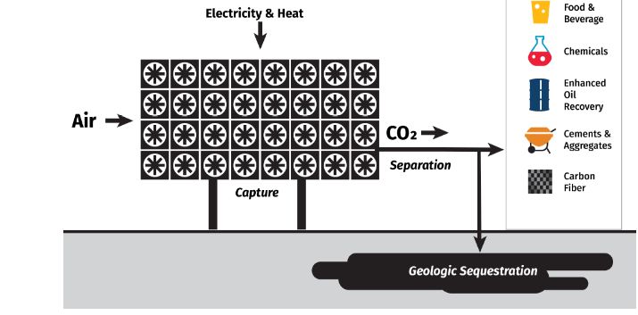


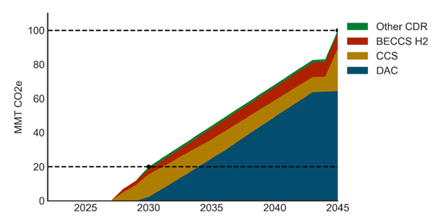
Progressing Climate Leadership and Energy Transition Through Direct Air Capture (DAC)
  Carbon TerraVault is forming a DAC Hub consortium to accelerate a Direct Air Capture and storage solution (DAC+S) for California through its wholly owned subsidiary CTV Direct¹
  WHAT IS DAC+S?
  Direct Air Capture plus Storage (DAC+S) is a technological solution that can remove and then permanently store decades-old atmospheric carbon in underground reservoirs using low carbon emission energy
  DAC+S reduces overall levels of CO₂ in the atmosphere and therefore is carbon negative
  WHAT IS A CALIFORNIA DAC HUB?
  A newly formed consortium, led by CTV Direct¹, EPRI and Kern Community College District (Kern CCD), seeks to bring together like-minded energy transition industry, technology, academia, national labs, community, government, and labor participants with the main goal to create and accelerate the development of the State’s first full scale DAC+S hub
Source: World Resources Institute
  WHY FORM A DAC CONSORTIUM IN CALIFORNIA?
  California has ample access to sustainable Carbon Dioxide Removal (CDR) credits², advanced technologies, world-leading research institutions, and supportive government-driven financial incentives
  CarbonTerraVault leads in EPA Class VI permit applications for CO₂ non-EOR storage reservoirs in California³ that are supplemented by extensive existing infrastructure that can be repurposed to further advance DAC+S across California
  California has ambitious climate targets that require CDR for success⁴
  WHY IS IT IMPORTANT?
  Acceleration of DAC+S in California can provide positive economic impacts, create high-paying jobs, successfully and sustainably reduce CO₂ emissions, and help the state lead in the energy transition with long-lasting benefits for Californians and our communities
~66
MMT for DAC⁴
Source: CARB
16
(1) CTV Direct is a wholly owned subsidiary of Carbon TerraVault focused on DAC. (2) Source: “Big Tech’s carbon removal scheme announces its first purchases”, Protocol, June 2022. (3) Source: EPA. (4) California’s leading goal for Carbon Direct Removal of 100 MTPA, of which ~66 MMTPA is projected to be from DAC per CARB Scoping Plan. Source: CARB.
Notes:
WE should
define DAC
Explain/set vision for the consortium
Show potential funding.
I think we do that but theres too many words and I wonder if there’s a way to reformat/simplify this slide

Slide 17



Development Vision
  HOW WILL IT BE DEVELOPED?
  The first DAC Hub is targeted for Kern County and is expected to store CO₂ at the CTV I reservoir¹. The hub is expected to expand to other locations across the state to store CO₂ in non-EOR reservoirs while providing high-paying energy transition driven jobs and training programs for reskilling workers, and helping California reach its carbon removal goals
  HOW WILL THIS BE FUNDED?
  A letter of Intent has been submitted by California DAC Hub for funding under the U.S. DOE $3.5B Regional DAC Hubs Initiative²
California Direct Air Capture HUB
Potential total funding amount of
  Under the U.S. Department of Energy (DOE) Regional DAC Hubs Initiative
~$875MM²
45Q
$180 Value (per MT of CO2) for Carbon Storage³
DAC Hub
LCFS
~$86 Est. Value (per MT of CO₂)⁴
Permanently Store Atmospheric CO₂ Using Low Carbon Energy
CDR Credits
Voluntary CDR Credits Market
(1) CRC has applied for EPA Class VI permits and the environmental review has begun for two initial permanent carbon capture and storage (CCS) vaults at the Elk Hills Field – which are collectively referred to as Carbon TerraVault I. (2) DOE has established a program under which the Secretary of Energy shall provide funding (total funding amount of $3.5B) for eligible projects that contribute to the development of four regional direct air capture hubs. Potential total funding amount for California DAC Hub was estimated by dividing the total funding between four potential hubs. Total funding amount might vary based on DOE grants. Source: DOE (https://www.energy.gov/oced/regional-direct-air-capture-hubs). (3) DOE. (4) Source: LCFS December 2022 weighted average price of $86 per MT of CO₂ - The California Air Resources Board.
17
Notes:
WE should
define DAC
Explain/set vision for the consortium
Show potential funding.
I think we do that but theres too many words and I wonder if there’s a way to reformat/simplify this slide

Slide 18










































Together We Can Achieve Bigger and “DAC” Things
Industry
Dac technology
ACADEMIA
NATIONAL LABS
Lead DOE Applicant Represents a Public-Private Partnership of Leading CA Community, Academic, DAC, and Carbon Storage Organizations
Community
GOVERNMENT
LABOR
18

Slide 19

California Is Leading the Climate Charge and Creating Energy Transition Jobs
“This project is more than a shared DAC infrastructure project; it serves as a hub model that delivers community benefits and jobs for other parts of the U.S. that also face climate change induced challenges.”
- Fiona Ma, California State Treasurer, February 2023
19

Slide 20
CRC’s Additional Projects Further Advance California’s Decarbonization
With Solid Partners

Slide 21



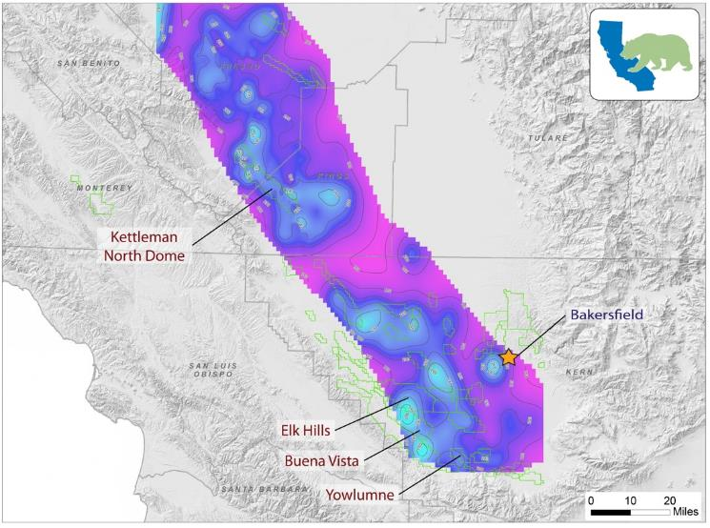
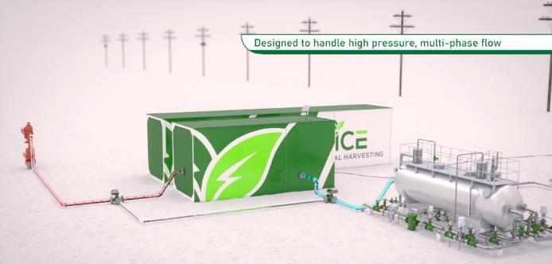
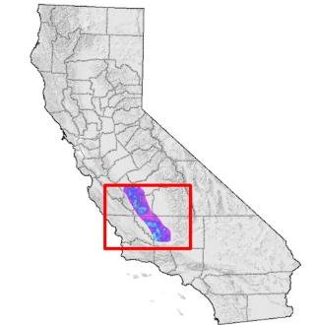
Exploring New Technologies to Further Advance Net Zero Energy Pathways
Est. ~6MW
of Geothermal Opportunities in SJB
Partnering with ICE Thermal Harvesting (“ICE”), who was awarded a ~$2MM “Wells of Opportunity” grant from the DOE
Provides an avenue for CRC to pilot a new zero-carbon energy technology
Potential commercial benefits: field electrical cost reductions, decreased emissions, postponement of asset retirement obligations, increased reliability of power and improved economics
Project kicked off in October 2022 and is expected to last 3 to 4 years with a potential for free zero-emissions electricity capable to power 6 wells
Initial planned location at Elk Hills with prospects to expand this technology to other fields or to other applications:
  Areas of Elk Hills, Buena Vista, Yowlumne, Kern Front, and Kettleman are associated with geothermal opportunities
Source: ICE Thermal Harvesting, CRC Internal.
21
Notes:
Move away divestitures
Well in change mix, lower price deck in change psc effects
Boe flat – need additional data
No psc effects
5 out of 8 operating rigs in California, need Kern county EIR
Add data on Kern county EIR
Delay- don’t use

Slide 22
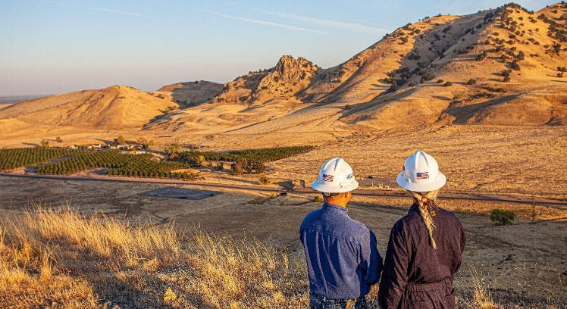

Blue Ammonia Will Help Accelerate The Decarbonization of CA’s Agricultural Sector
BLUE AMMONIA – ENERGY TRANSITION MIX IN CALIFORNIA
U.S. is the world’s third largest producer of ammonia, consuming ~ 19.5 MMTPA of ammonia which is mainly used in the agricultural sector¹ (~88% of U.S. ammonia consumption was for fertilizer use²)
CALAMCO represents the majority of agricultural ammonia demand in California³ where most of it is imported into Stockton, Sacramento⁴ and other entry points from other U.S. states and countries such as Trinidad and Tobago
  CALAMCO’s terminal at the Port of Stockton, the only ammonia marine import terminal in California, currently hosts 40,000 tons of ammonia storage tanks⁵
California produced low carbon blue ammonia can replace imported grey ammonia to create local employment, lower the carbon intensity of fertilizers used in the agricultural sector (~9% of CA’s 2020 total GHG emissions⁶) and further drive the technological evolution of energy transition in California
ABOUT GRANNUS
Grannus is an independent clean-tech company that is building a portfolio of blue ammonia and hydrogen production facilities to supply the agriculture, mobility and marine fuel markets
Grannus is using patented technologies that produce effectively no emissions and exceed the conversion efficiencies of today’s best in class blue ammonia and hydrogen production facilities’ designs
Headquartered in Tucson, AZ, Grannus offers a full suite of technology-enabled project development, project management and engineering solutions in the U.S. and North America
“As a next generation clean-tech company, we are excited to partner with such a knowledgeable carbon management provider as Carbon TerraVault due to their unique vault positioning in the heart of Northern California’s industrial sectors, strong subsurface expertise, and their leadership in CA’s new energy economy …”
- Matthew Cox
Chief Executive Officer of Grannus
Note: Blue ammonia is ammonia produced with near zero, or minimal carbon emissions. (1) Source: EIA based on 2020 data; Economic Research Service - U.S. Department of Agriculture; U.S. Geological Survey, Mineral Commodity Summaries, January 2022; CA Department of Food and Agriculture. (2) Source: “Ammonia’s Potential Role in a Low-Carbon Economy”, Congressional research service, December 2022 (3) Source: CALAMCO (4) Source: KCRA, July 2022. (5) Source: CALAMCO’s public website. (6) Source: CARB website as of 2020.
22

Slide 23

Lone Cypress Track Record
ABOUT LONE CYPRESS
100+Years
Combined Successful Leadership Execution Experience
$5B
Worth of Assets Managed & Developed
$700+MM
Worth of Assets in Development
Lone Cypress has executed projects on behalf of some of the majors and largest E&P/Midstream companies in the energy sector with a variety of well-established strategic partners and industry leaders
Lone Cypress’ specialized projects span large midstream systems, RNG facilities, carbon capture and storage systems, hydrogen production and generation, waste to energy plant solutions and traditional oil and gas midstream facilities
Headquartered in Tulsa, OK, Lone Cypress offers a full suite of technology-enabled solutions
  Project Development & Project Management
  EPC contracting
  Asset operations
Lone Cypress Previous Projects
New Lone Cypress Hydrogen Project
New Energy Projects
Hydrogen | Elk Hills Lone Cypress Hydrogen Project with CTV JV as a Key Partner 30 TPD blue hydrogen steam methane reforming (SMR) facility Targeted FID in late 2023 Finalize engineering in 1H23 Formalize off-take arrangements by 2H23. The majority of the hydrogen production volume is expected to be supported by off-takers committed to energy transition in California once the project is FID First hydrogen production targeted in late 2025 Confidential - Lone Cypress Hydrogen Facility, Canada – Project Manager (Currently in late-stage development) 30 TPD SMR Facility
Waste and Energy | Waste to Renewable Fuels Facilities
“CTV’s unique expertise in subsurface operations and permitting, large CO₂ storage position and ability to deliver on highly complex and capital-intensive projects provide us with a clear line of sight as we continue to evaluate additional projects in California …”
- Greg Brooks,
President and Founder of Lone Cypress Energy Services
23
Source: Lone Cypress. For more information, please visit www.lonecypressenergyservices.com.

Slide 24

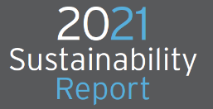



Why California Resources Corporation?
Strong Balance Sheet with Attractive Free Cash Flow Generation
Enhanced Shareholder Returns Strategy
Leading Carbon Management Business
Strong ESG & Social Platform
24
Notes:
Add slide … summary of quarter +deal
CMB expenses will be funded / paid back by CTV JV with Brookfield

Slide 25
 | Michael Preston (818) 661 - 3702 Michael.Preston@crc.com

